Slide 1


Slide 2
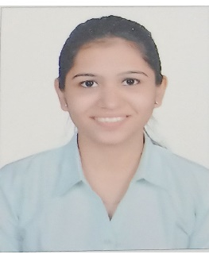
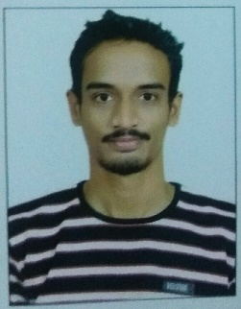
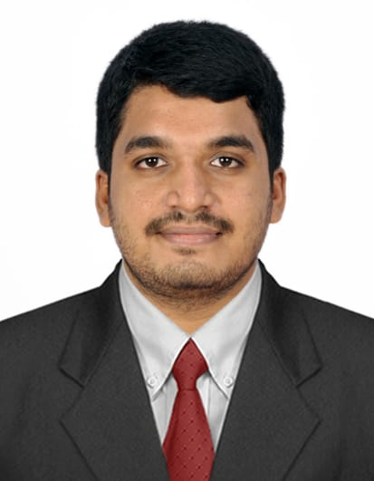
Project Highlights
Project Name : Calci/Unit Converter
Team Size : 3
BU Mentor Name : Milind Hatkhamkar, Neha Bandi, Kalpesh Patil
Shweta Melavane
PS#99002488
2009BLRICP01
B.Tech, EXTC
Time Management, Teamwork
Divyesh Marne
PS#99002456
2009BLRICP01
B.Tech, EXTC
Critical thinking, Problem solving
Pavan Raj
PS#99002460
2009BLRICP01
B.Tech, ECE
Team player

Slide 3
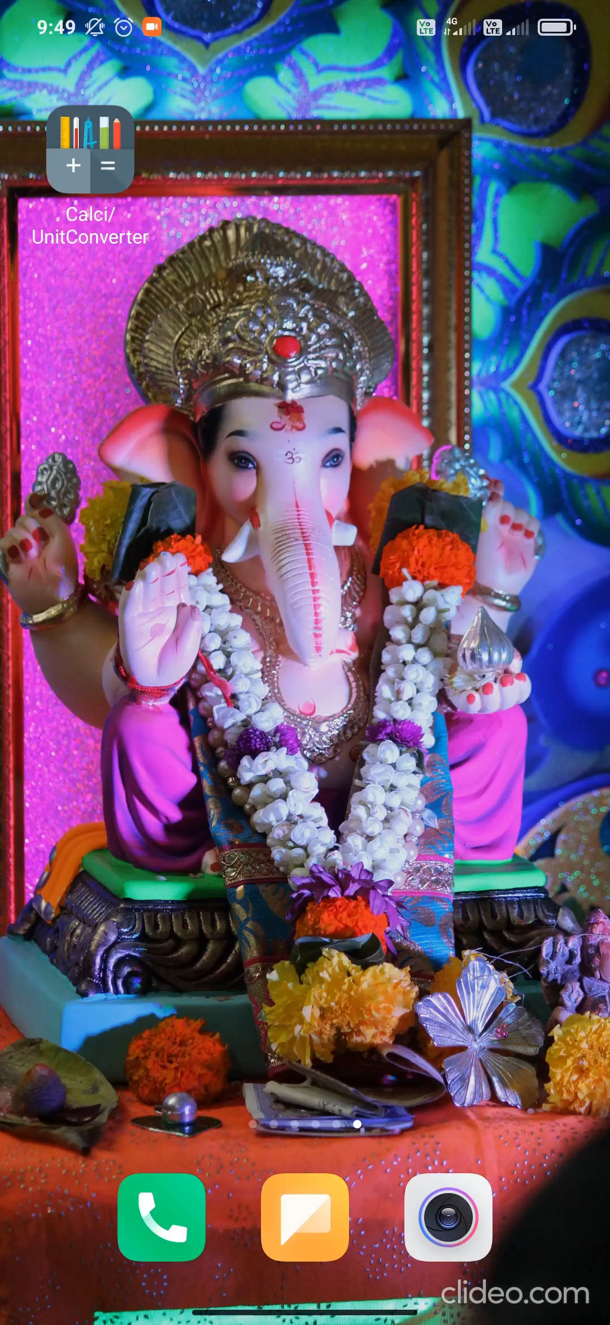
Project Video Snippet

Slide 4
Future development that can be implemented further
More functions in the calculator can be added.
Can make scientific calculator.
More unit converters can be added.
Overall layout can be improved.

Slide 5

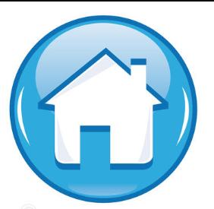
Thank You !

